Slide 1


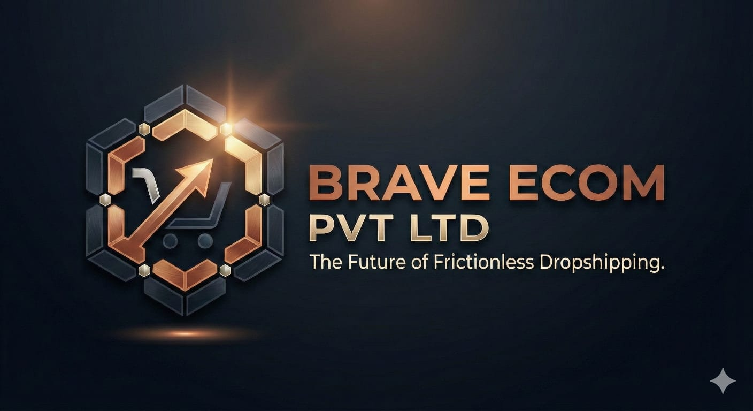




Global Operations
Global Market CAGR
Iron Reserve
40%
22.6%
Treasury protection
Through 2033
BRAVE ECOM PVT LTD
Compliance
IPO Roadmap
Building a Legally Fortified, Global High-Growth Institution
100%
3 Years
Zero risk from inception
Clear pathway to listing
Tech-Enabled Dropshipping with Blue-Chip Financial Discipline
© 2026 Brave Ecom Pvt Ltd. All Rights Reserved.

Slide 2





Company Overview: The Brave Ecom Advantage
Global Operations
Ledger Consistency: Global inventory sync
22.6%
40%
Frictionless Onboarding: Cross-border integration
Global Market CAGR
Iron Reserve
100% Compliance: Global regulatory adherence
30-40%
20-25%
ESOP Pool: Section 62(1)(b)
Audit Ready: Quarterly + Annual
Turnover Reduction
Interest Coverage
"Invest in a startup that combines the agility of global tech innovation with the stability of blue-chip financial discipline."
Y1
Y2
Y3
Global Trust & Traction
International Scale
Global Pre-IPO
© 2026 Brave Ecom Pvt Ltd. All Rights Reserved.

Slide 3












Investment Thesis: Why Brave Ecom?
Global Operations
The Core Promise
Built to Grow Fast
Built to Last
Global dropshipping giant
Blue-chip financial discipline
Regulatory Compliance
Conservative Treasury
Full adherence to international regulations
40% Global Iron Reserve in high-yield instruments
Legal Shield
Financial Buffer
ESOP Alignment
Clear IPO Pathway
International structure protects global assets
Interest covers 20-25% of global operations
Global employee ownership creates intrapreneur culture
Structured 3-year roadmap to international listing
Global Wealth Creation
Talent Retention
Market Resilience
Global ESOPs reduce key person risk
Diversified international revenue streams
10x
Global IPO Liquidity
Early Investors
Founders
10x Growth
ESOP Holders
Value Realization
© 2026 Brave Ecom Pvt Ltd. All Rights Reserved.

Slide 4

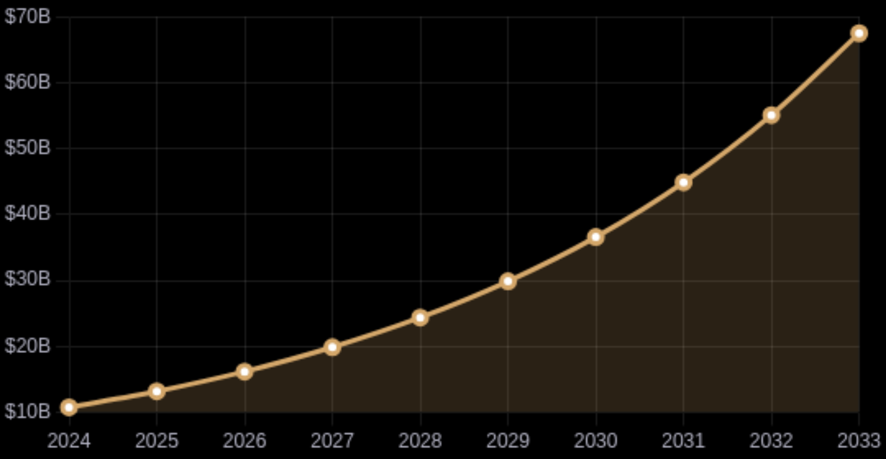











The Global Dropshipping Opportunity
Global Operations
Global Market Size & Growth
$10.8B
$67.5B
2024 Market Size
2033 Projection
22.6%
Compound Annual Growth Rate (2025-2033)
Global Internet Penetration
Worldwide Smartphone Adoption
Cross-border Payment Systems
Fashion & Apparel
35%
International Trade Policies
Electronics & Media
28%
Global Logistics Networks
Home & Living
18%
Zero-Investment Models
•
Toys & Hobby
12%
Food & Personal Care
7%
North America
Asia-Pacific
Mature Markets
Fastest Growing
Europe
Emerging Markets
Premium Markets
High Potential
© 2026 Brave Ecom Pvt Ltd. All Rights Reserved.

Slide 5

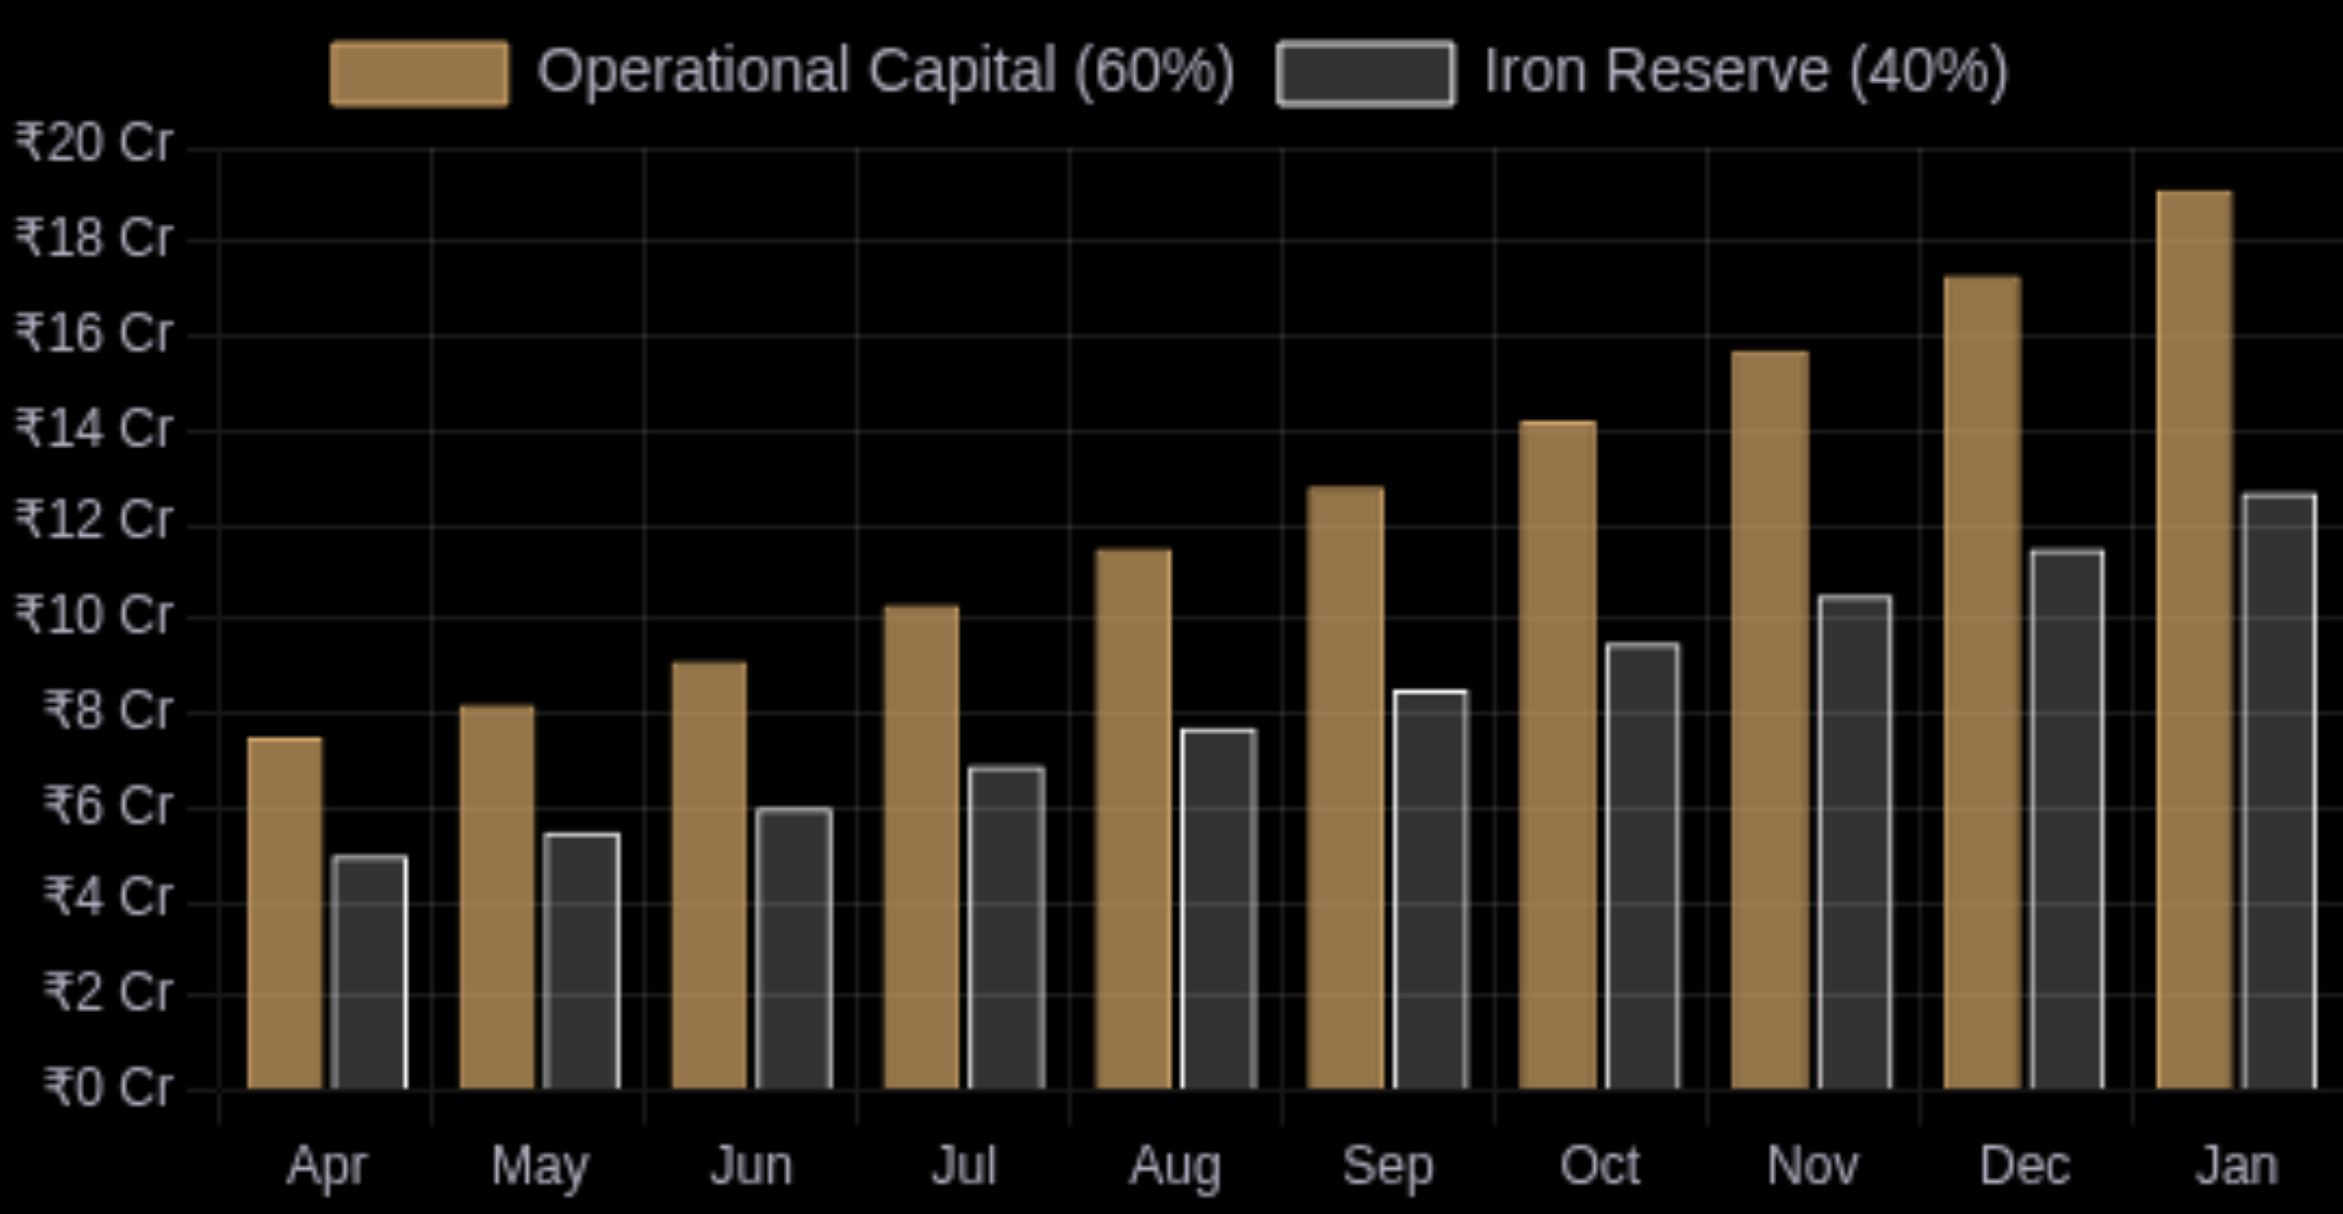
















Strategic Treasury: The Fortress Policy
Global Operations
3 Years
40%
25%
Steady Net Worth Growth
Asset Growth Target
Liability Reduction
Monthly-wise capital gains from global trading operations are systematically allocated to diversified investment vehicles with proper banking backing, ensuring steady growth of company assets while reducing liabilities over the 3-year period.
Operational Capital
Iron Reserve
40%
60%
Primary Banking Partner
Quarterly Settlements
Current Balance
Strategic reserve for global financial resilience
Deployed into high-velocity global growth initiatives
4
₹10.1 Cr
Kotak
Multi-currency Deposits
Global financial reporting
Strong global financial position
International financial institution
Global Inventory Network
International Instruments
International Marketing
Global Safety Nets
Day-wise global trade data is meticulously tracked and analyzed to optimize international investment decisions, with all transactions backed by established banking institutions for maximum security and compliance across markets.
Cross-border Blockchain
International governance on reserves
Global treasury review & reporting
Board-approved international policy
Full transparency on global funds
© 2026 Brave Ecom Pvt Ltd. All Rights Reserved.

Slide 6











Corporate Governance: The 'People-First' Framework
Global Operations
Mr. Sanjay Patil 80% Equity
Our BDM team develops the business and attracts domestic and international clients using customized strategies tailored to market needs.
CEO & MD | MCA Graduate, Mumbai University
Smooth business operations
Develop business growth strategies
Maintaining business compliance
Attract domestic and international clients
Authorized signatory for major decisions
Customized client acquisition approaches
Mrs. Puja Patil 20% Equity
Market research and competitive analysis
Co-founder | BE Engineer Graduate
Website development
Company promotion matters
Client profit timely disbursements
Limited Liability
Audited Transparency
Personal assets of directors and shareholders are legally shielded from business liabilities
Quarterly internal audits and annual statutory audits by reputable Chartered Accountants
Zero-Non-Compliance Policy
Brave Ecom operates with a "Zero-Non-Compliance" policy regarding the Indian Companies Act, 2013. We do not view labor laws as a burden, but as a retention engine.
Provident Fund (PF) & Gratuity
Medical & Insurance (ESI)
100% compliance with EPF Act
Comprehensive health coverage
Legal Framework
Minimum Vesting
Section 62(1)(b)
1 Year
30-40%
Tax Treatment
Board Approval
Human Capital Advantage
Perquisite + CG
Required
Our strategy reduces turnover significantly, fostering a stable, motivated workforce that drives sustainable growth
This transforms employees into "intrapreneurs." They don't just work for a salary; they work for equity appreciation, driving them to minimize friction and maximize profit just like the founders.
Below Industry Average
© 2026 Brave Ecom Pvt Ltd. All Rights Reserved.

Slide 7



3-Year Global Growth Roadmap to IPO
Global Operations
Year 1
Year 2
Year 3
Global Trust & Traction
International Scale & Structure
Global Pre-IPO Phase
Validate Global Core Models
3x Global Market Expansion
Global Market Dominance
Cross Target ARR Threshold
10x International User Base
Strategic International M&A
Global Blockchain Validation
Global Tier-1 VC Partnerships
Global Entity Conversion
International Core Team
Global IPO-Ready Finance
Global DRHP Filing
50+ Global Verified Suppliers
International CFO & Compliance
NSE Mainboard Global IPO
Global Seed Round
Global Series A Funding
Global Series B / Growth Fund
Strategic Angel Investors with Global Retail-Tech expertise
Top-tier VCs specializing in International Retail-Tech
International Capital for Worldwide Expansion
1
2
3
4
Global Pre-Filing
DRHP Filing & Review
Global RHP & Marketing
Global Issue & Listing
Appoint international intermediaries, conduct global due diligence
SEBI reviews global operations and financials
International roadshows, global investor presentations
IPO opens to international investors, global listing
6-12 months
30-45 days
21+ days
T+6 days
10x
Global Revenue Growth Target to IPO Readiness
© 2026 Brave Ecom Pvt Ltd. All Rights Reserved.

Slide 8









Built to Grow Fast, Built to Last
Global Operations
Brave Ecom: A Global Investment Vehicle
10x
22.6%
3-Year
Global Revenue Growth
Global Market CAGR
Global IPO Roadmap
Zero Risk
40%
ESOP Aligned
Global Compliance
Global Iron Treasury
Global People-First
invest@braveecom.com
+91 98765 43210
www.braveecom.com
Brave Ecom Pvt Ltd - A Legally Fortified, Global High-Growth Institution
© 2026 Brave Ecom Pvt Ltd. All Rights Reserved.

